Slide 1
Netflix Entertainment
By: Jazmin Burnett-Birdsong
Hope McCadden
By: Jazmin Barnett-Birdsong
Hope McCadden

Slide 2

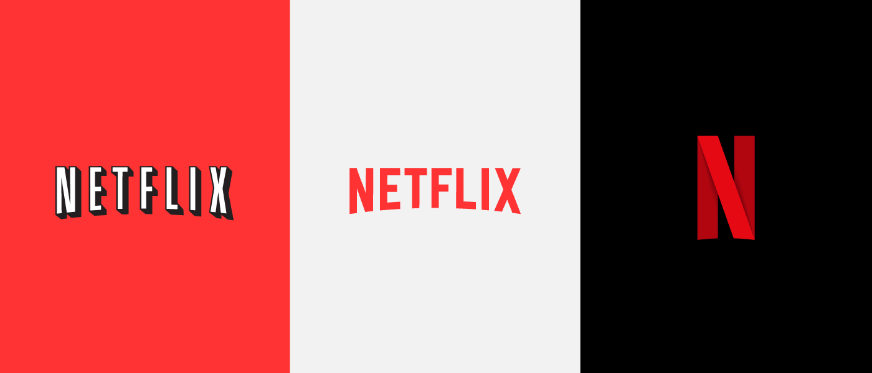
Jazmin Barnett-Birdsong jazsong7@gmail.com
Hometown: Chicago
Purdue University math degree
Univ of Michigan Educational Studies graduate / Rackham Fellowship
Child of 20+ year educator for Chicago Public Schools
“Data Science allows the math nerd and the researcher within me to become besties.”

Slide 3

Hope McCadden hope.mccadden@outlook.com
Hometown: North Carolina native
ECPI University: Information Systems
18 yrs.' experience in IT
6 yrs.' experience in Quality
“I feel that Data Science enables an individual to position themselves to profit whether its in healthcare, financial and entertainment.”

Slide 4
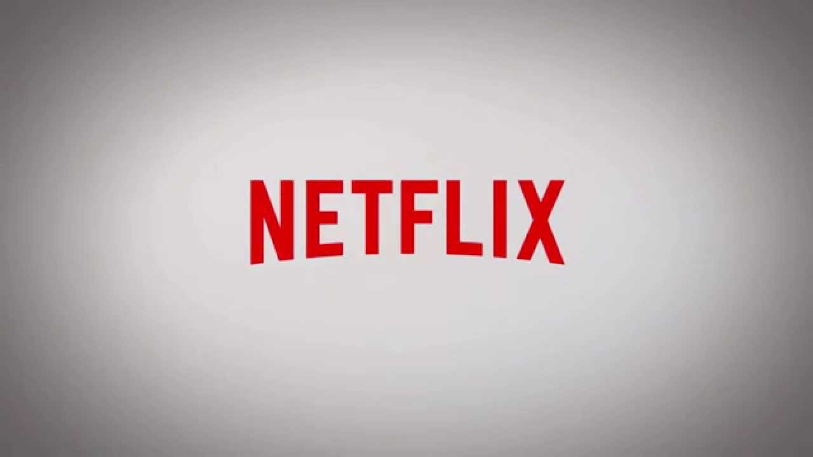


Slide 5
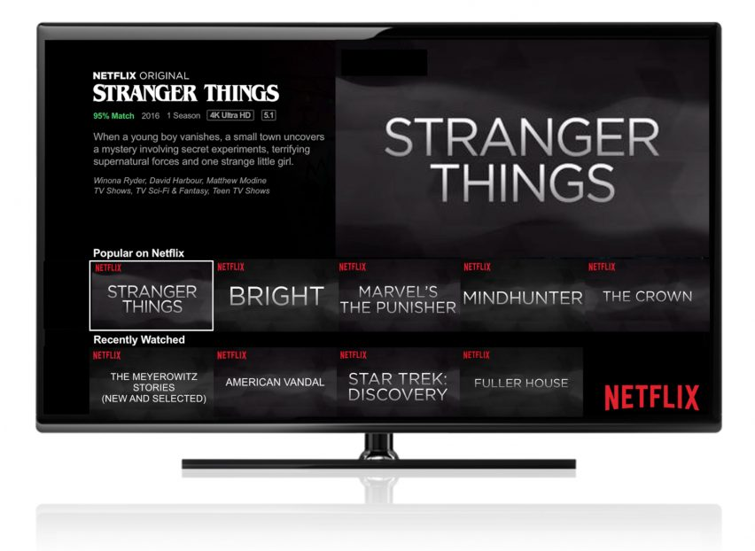
Background
Netflix.com launched its mail-order DVD rental site in 1998
In 2000, Netflix began recommending movies to its users basing predictions on the user’s ratings of other films
As of 2007, Netflix introduces streaming service
By 2010, Netflix offers streaming to mobile devices and introduces a profile dedicated to children’s content
2020 Netflix is a household name, has its own button on most remote controls, is the most nominated studio at the Emmys

Slide 6
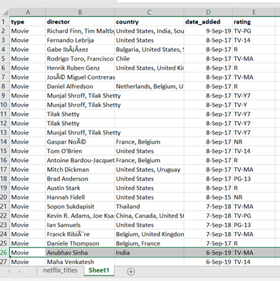
Questions & Methods:
Can content be predicted accurately?
Random Forest Predictions in Python
Was there significantly more content released for adults than for children?
Independent Chi-Square in Python
Using Netflix Streaming content, which genre(s) is the most lucrative* for TV Shows and Movies?
Independent Chi-Square in Python
Test assumptions with contingency table
Correlations
Data Visualization
Tableau

Slide 7
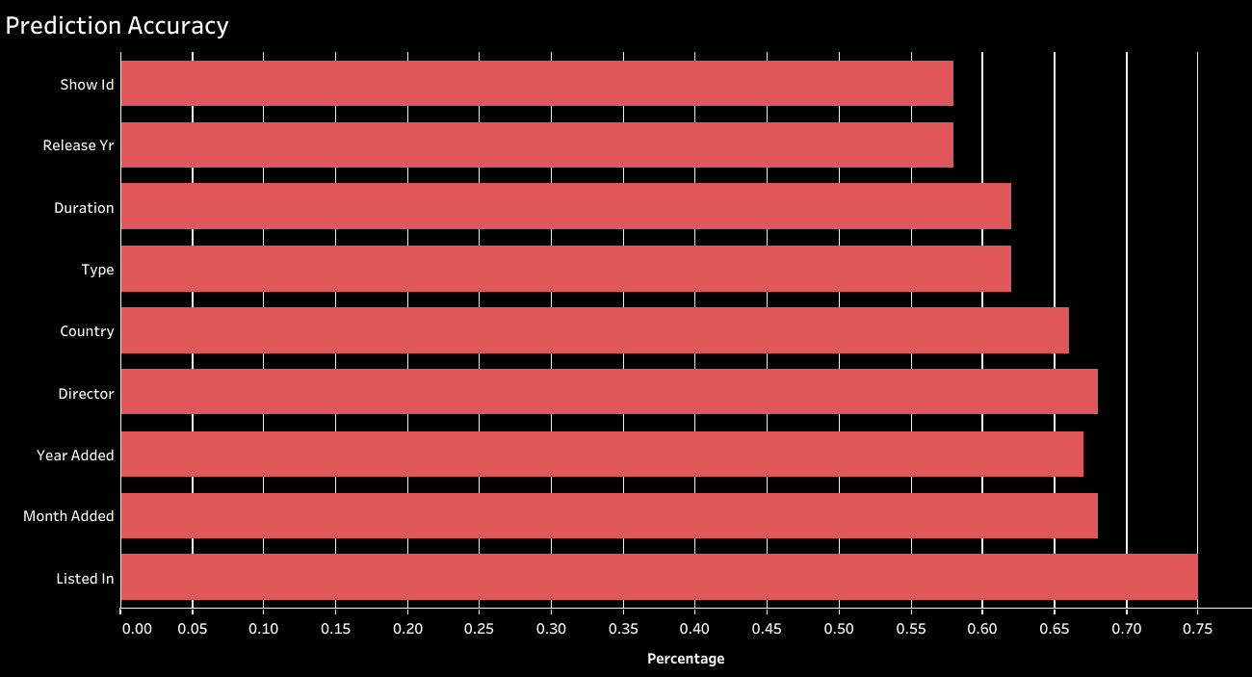
Netflix: Random Forest Content Prediction Accuracy
Can the content’s age group be accurately predicted?
Starting with the Show ID as a base line
Adding each column below one-by-one
Excluding columns with unique information
Title
Description
Cast
Excluding the rating column as it was recoded to identify the content’s intended age group
I would recommend more data to improve the accuracy level to at least 90%

Slide 8
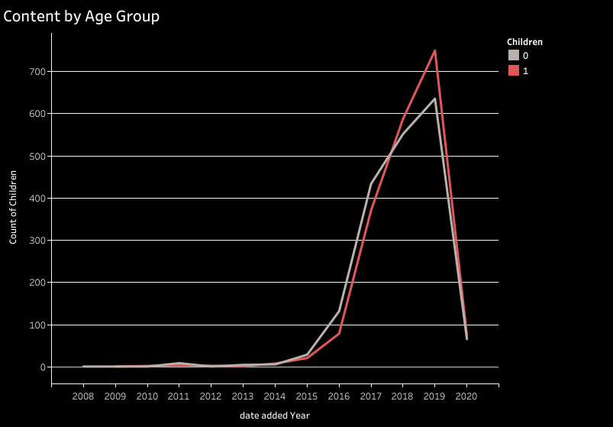

Netflix: Content by Year
Amount of content added starts to pick up after 2015 for both age groups
More adult content added than children’s 2015 – 2017
Children’s content starts to spike 2016
Amount of children’s content surpasses adult’s content 2018 & 2019Amount

Slide 9
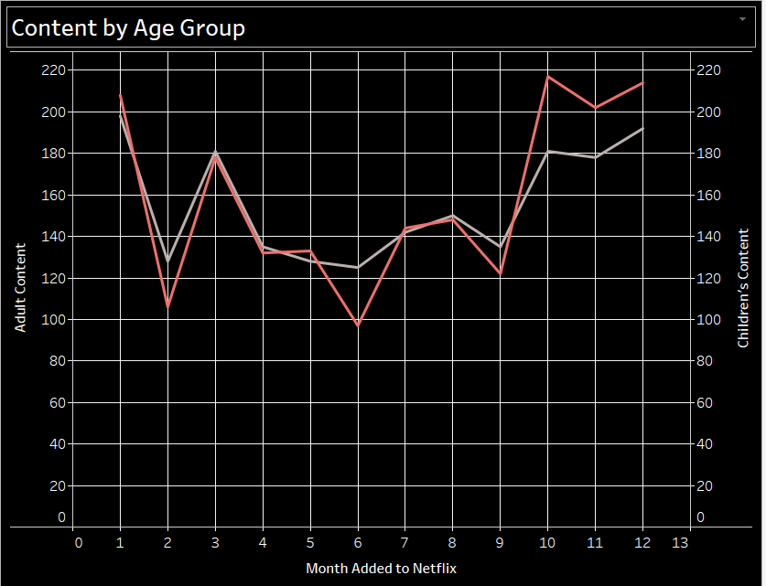
Netflix: Content by Month
January to May: Adult content trends higher than children’s
June to December: Children’s content trends higher than adult content
School’s out more during these months in the US

Slide 10
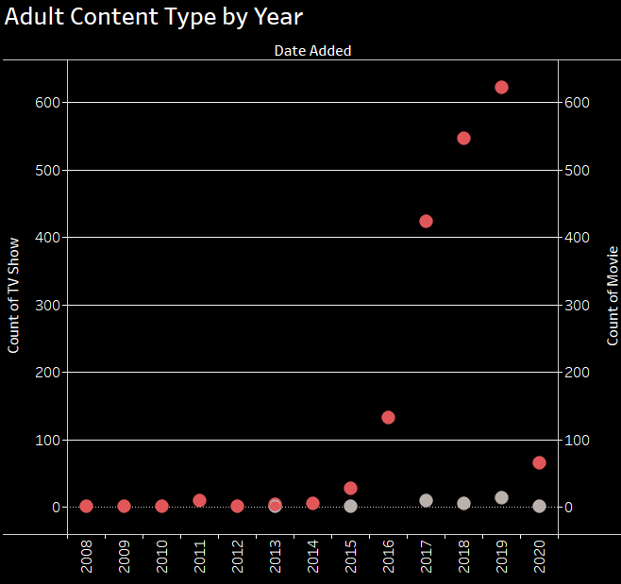
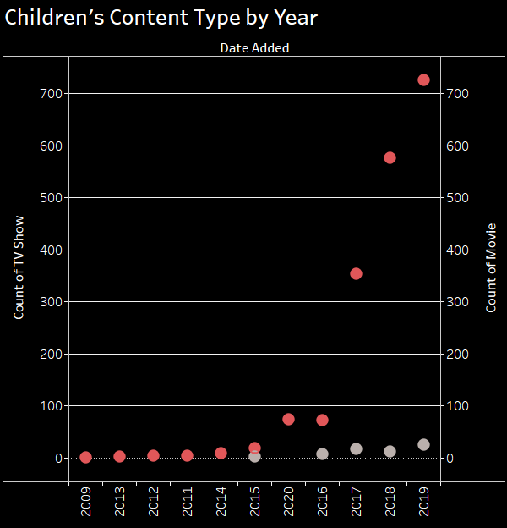
Netflix: Content Added by Type
Before 2015: There is very little content of either type
After 2015: Number of movies added to platform significantly increases
Greater amounts of movie content added than TV shows content
May be due to tv shows adding more seasons into an existing space vs adding totally new program content, unlike movies

Slide 11
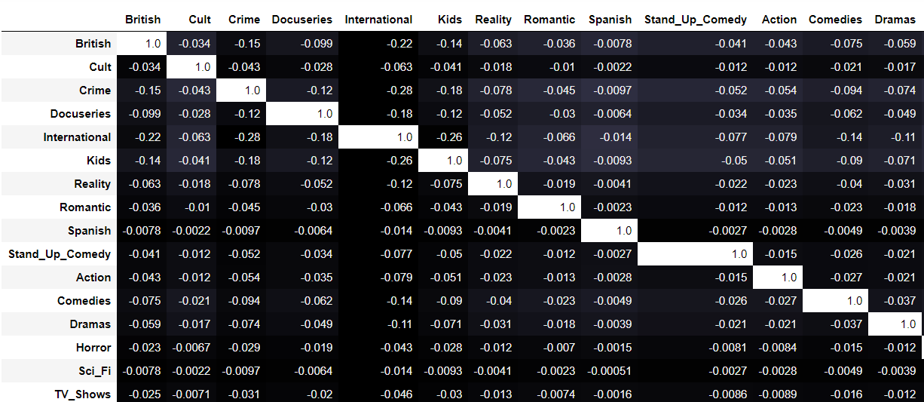
Genre Relationships
No relationship between genres
International is the most unrelated genre of all the genres

Slide 12
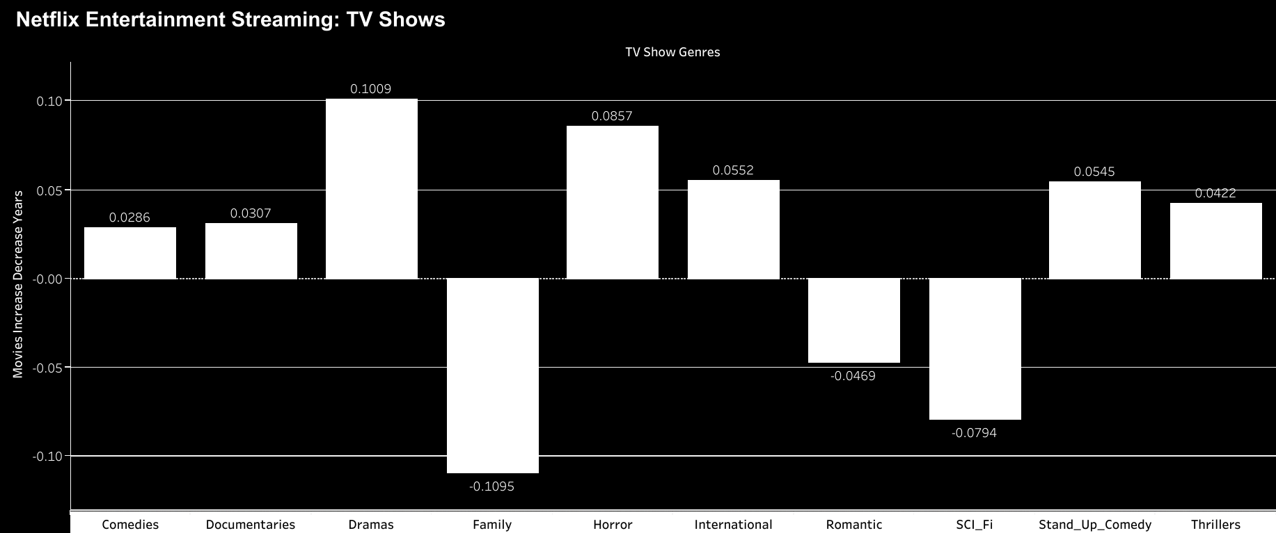
Annual Profit: TV
Drama increased the most compared to other TV Show genres
It has increased 10% over the last 12 years
Drama is the most lucrative genre for Netflix streaming content

Slide 13
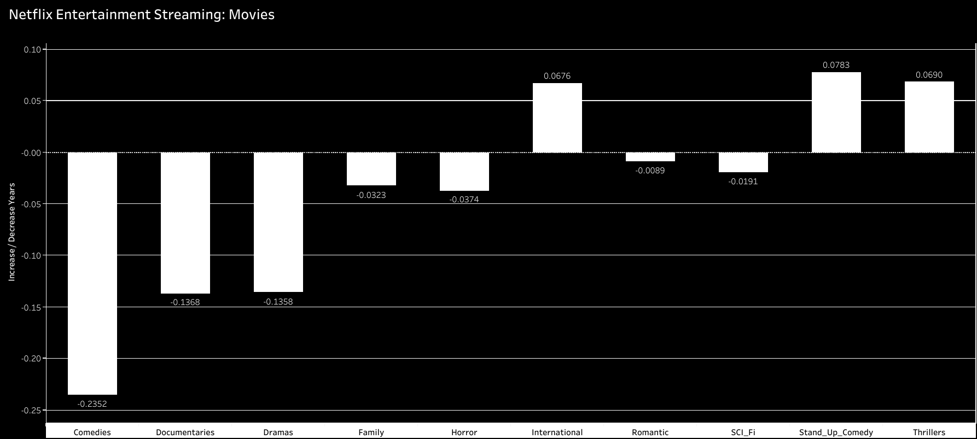
Annual Profit: Movies
Stand-up Comedy increased the most out of all the movie genres
Its has increased 8% over a 12 years timeframe
Stand-up Comedy is the most lucrative genre for Netflix movies
Comedies genre have decreased by 24% over the same time span

Slide 14
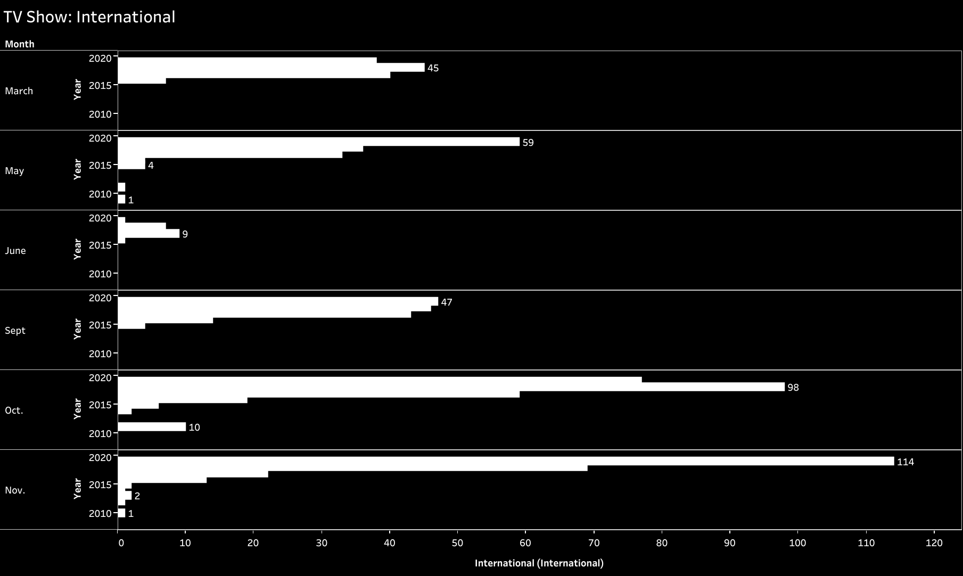
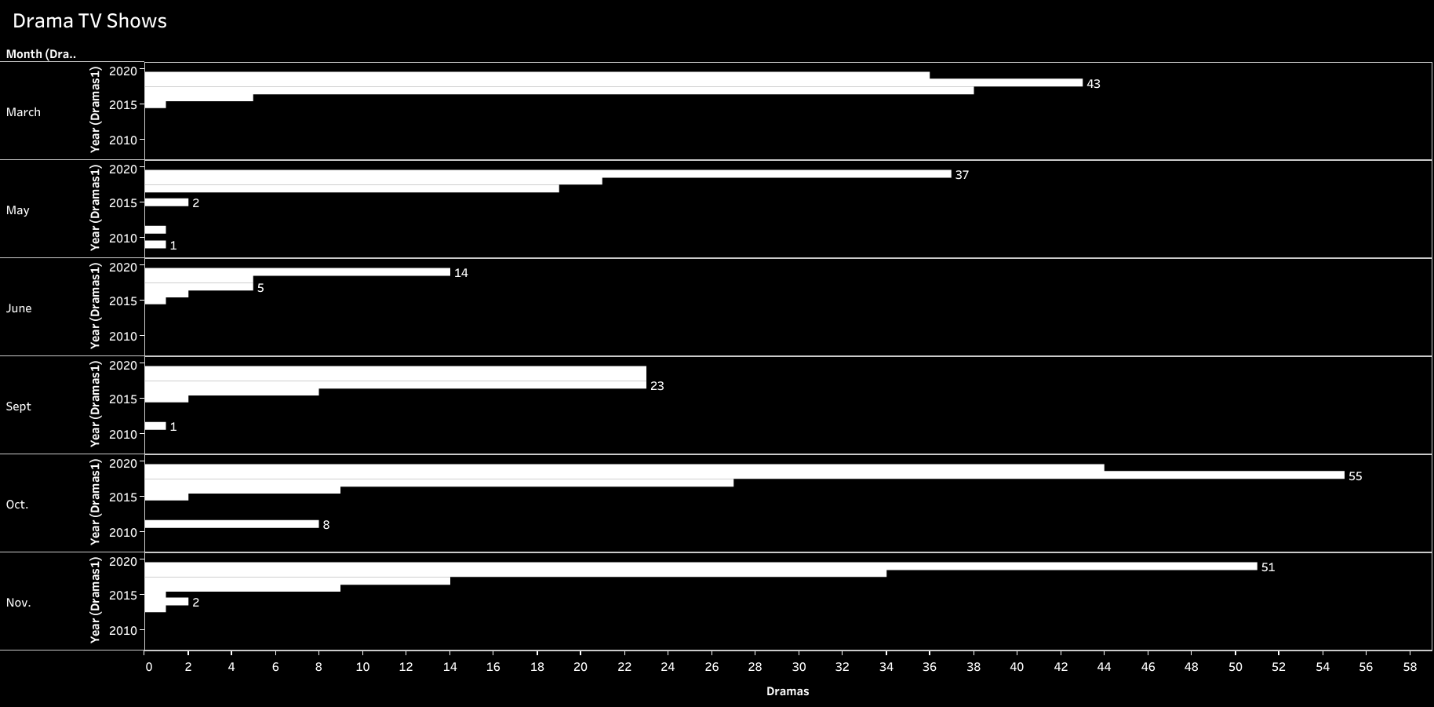
Monthly Profit: TV
International is the most profitable genre follow by Drama
Since 2016 the most productive months are Oct. and Nov.

Slide 15

Monthly Profit: Movies
Most movies with International or Drama genres are added in December
International is the most profitable genre follow by Drama
International
Drama

Slide 16
Summary
Since launching its streaming service in 2007, Netflix is trending toward adding more children’s content than adult content yearly
Monthly, Netflix added more adult content during the first half of the year and by June, added more children’s content than adult content
More movie content added than tv shows
Netflix have a plethora of streaming content with different genres. Neither of the genres has a relationship with each other, in fact they are unique.
During a 12-year time frame, Drama TV shows and Stand-up Comedy movies increased the most.
For monthly, all streaming content with International or Drama genres were added the most during December.
October and November are the most lucrative months for TV shows with International or Drama genres.
December is the most lucrative month for movies with International genre.

Slide 17
Conclusion
Consider:
Creating and releasing more original children’s content due to increasing competition for children’s content
Releasing more international children’s content
When streaming content is added to the Netflix platform, the 4th quarter is their most profitable quarter.
So, for the customer who enjoys Stand-up Comedy, International, and Drama TV shows or movies, acquiring a Netflix streaming service around the end of the year would be ideal.
Offering a discounted rate for an annual subscription versus the monthly subscription fee

Slide 18
Questions

